Slide 1
The Great Western Railway 1867
Lapstone Hill the first challenge

Slide 2
The Western railway line was operating to Penrith in 1864 and the next challenge was to ascend Lapstone Hill.
Cost constraints imposed by the Colonial Government meant that expensive tunnels could not be built and so a zig-zag layout was used to get the single track line over the top of Lapstone Hill.

Slide 3
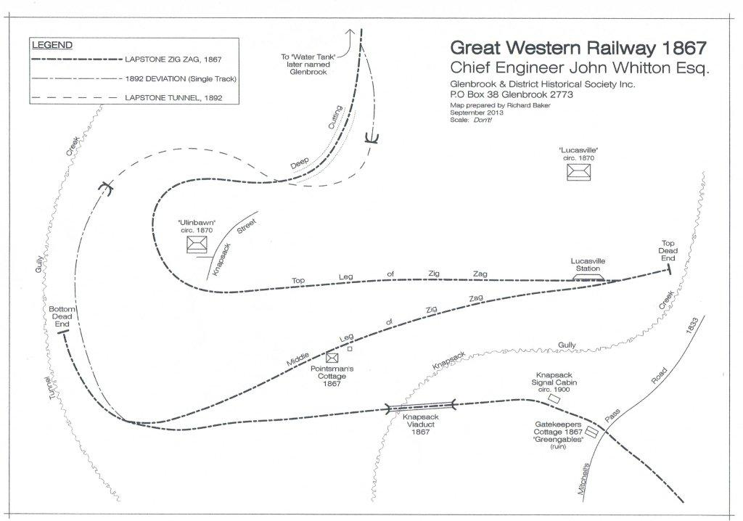

Slide 4
The limitations of the Zig-Zag were later eased by building a single track tunnel through the top of the ridge in 1892.
The single track tunnel caused almost as many problems as it was supposed to solve, so by 1910 it was decided to build a double track railway through the Glenbrook Creek gorge.
This route through the gorge is in use to this day and provides easily worked grades as far as Valley Heights.

Slide 5
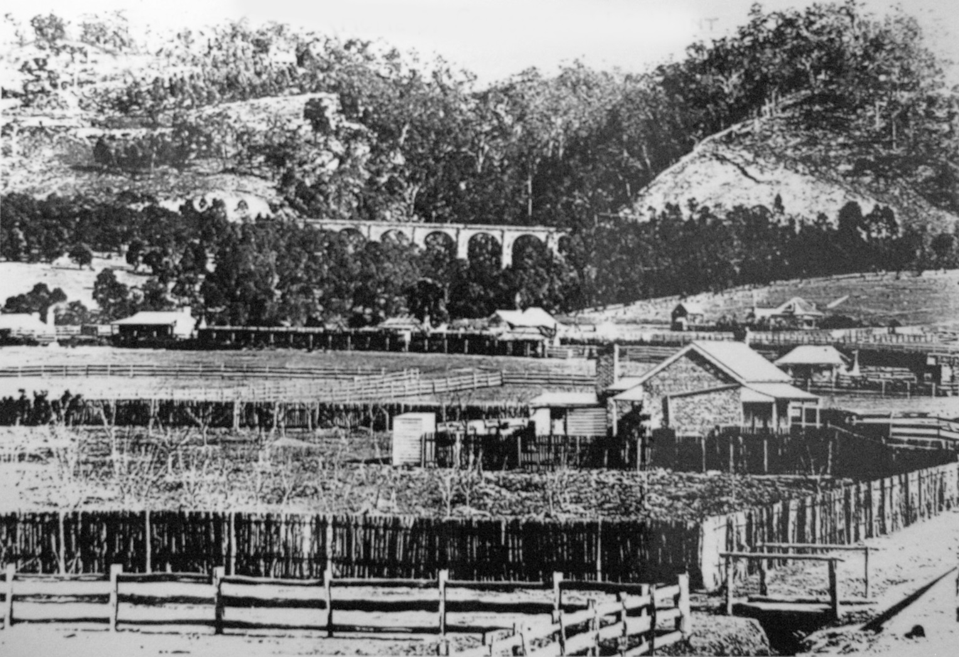
Knapsack Viaduct – viewed from Emu Plains- the first engineering challenge
Photo 1880

Slide 6
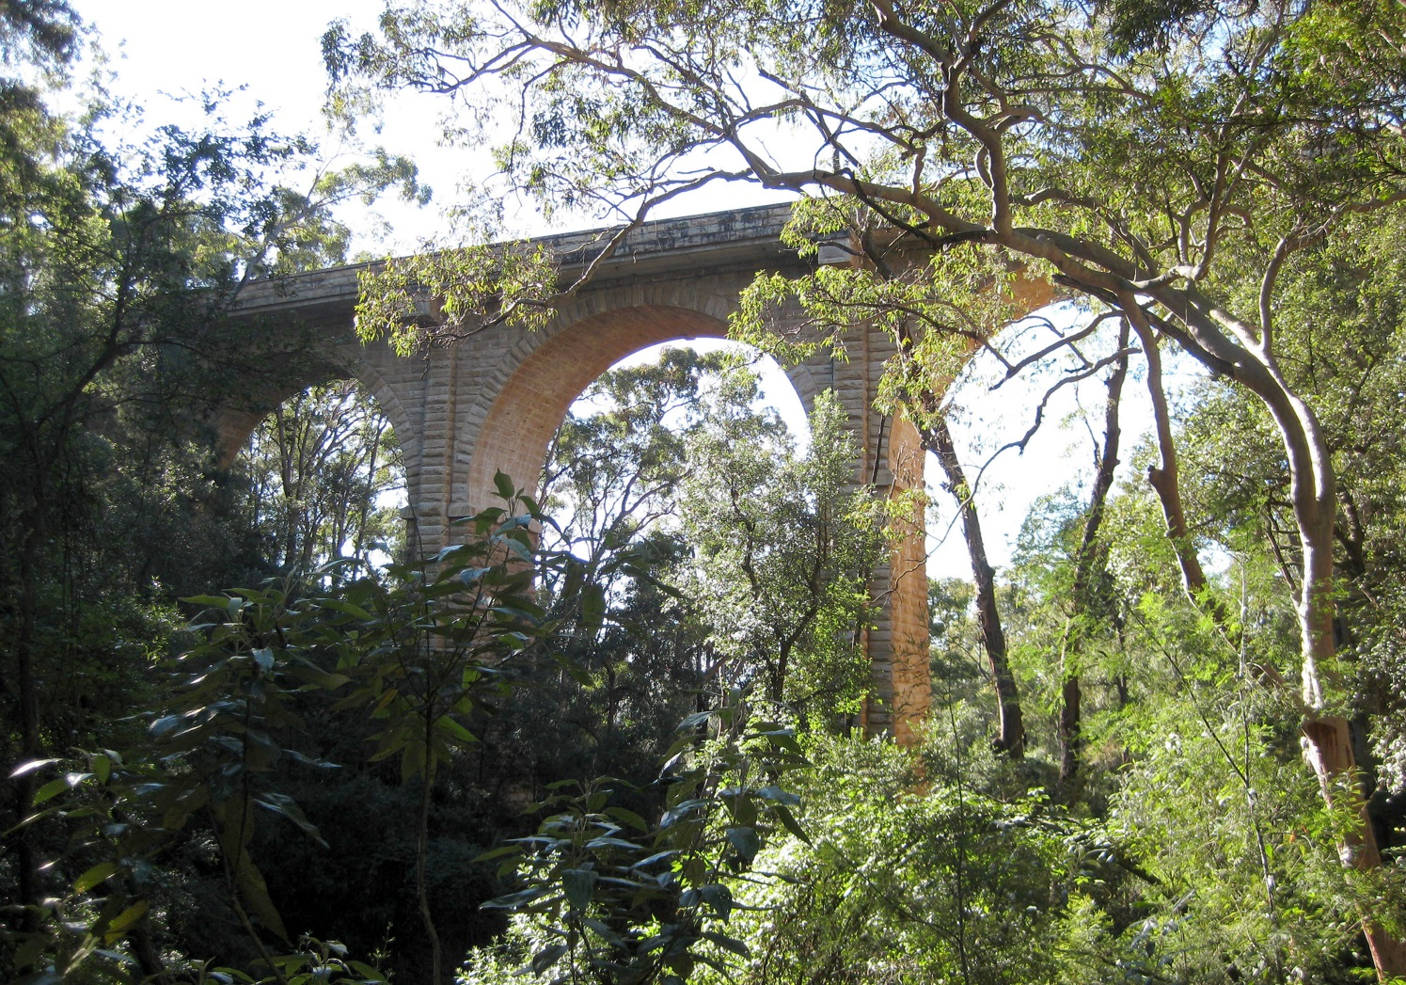
Knapsack Viaduct Photo 2010

Slide 7
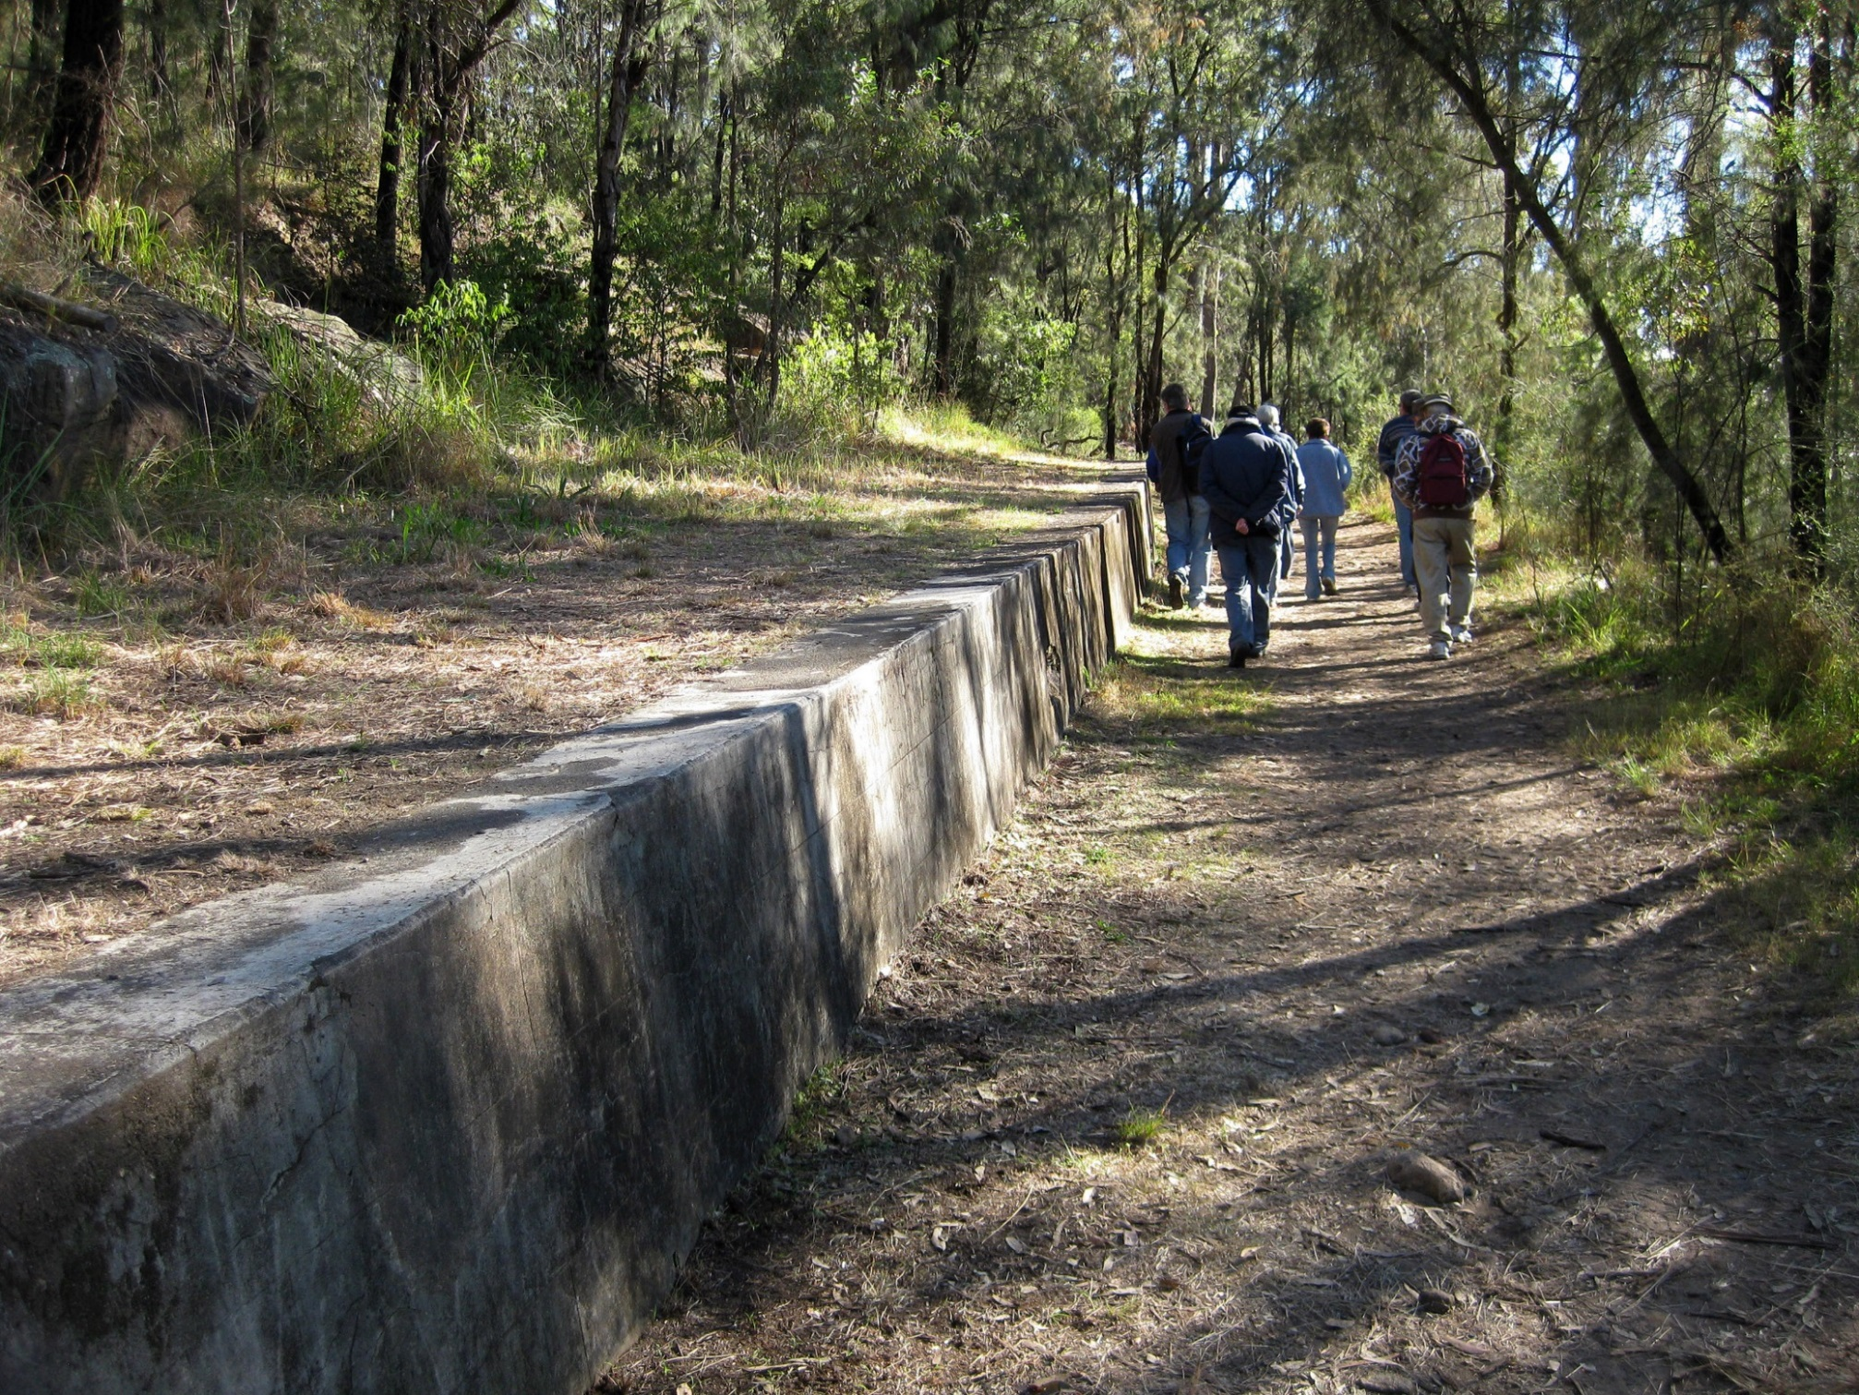
Lucasville station platform built 1874. Photo 2010

Slide 8
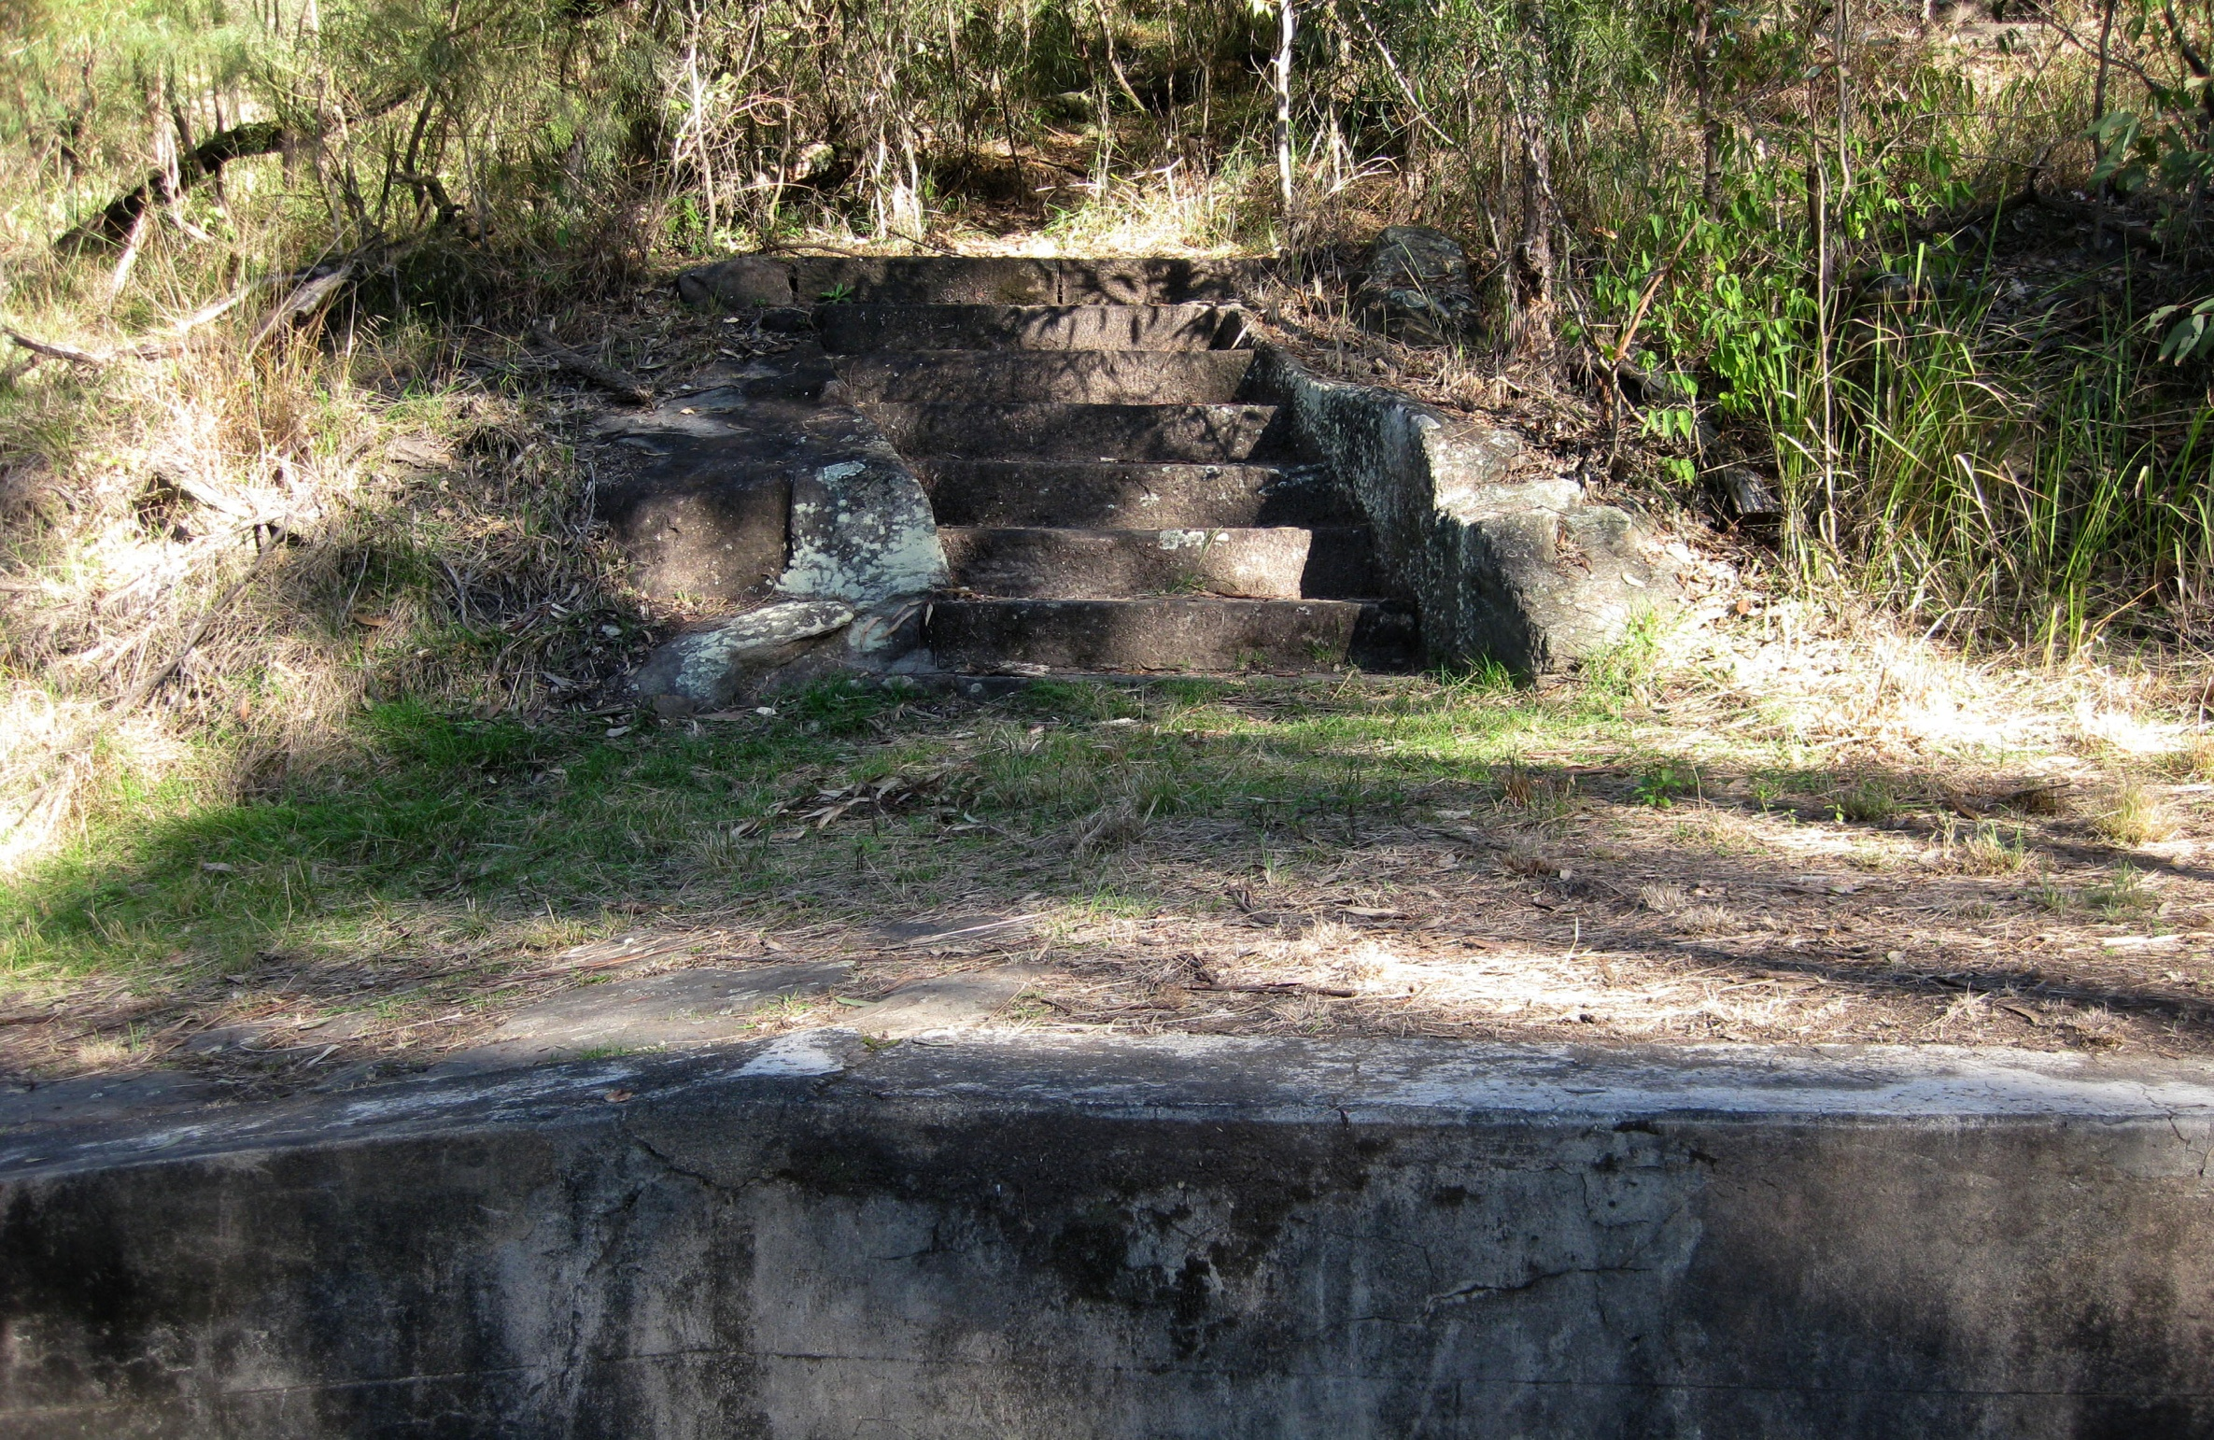

Slide 9
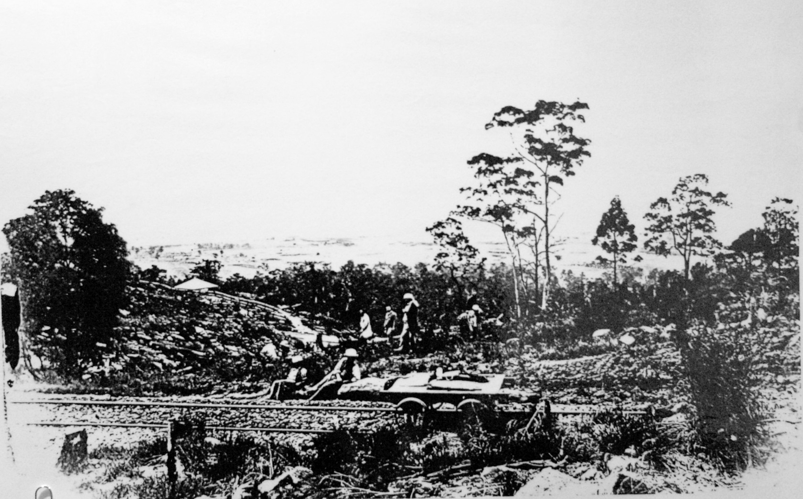
Top road of Zig Zag with workers and trolley, looking down towards Emu Plains
Photo about 1880

Slide 10
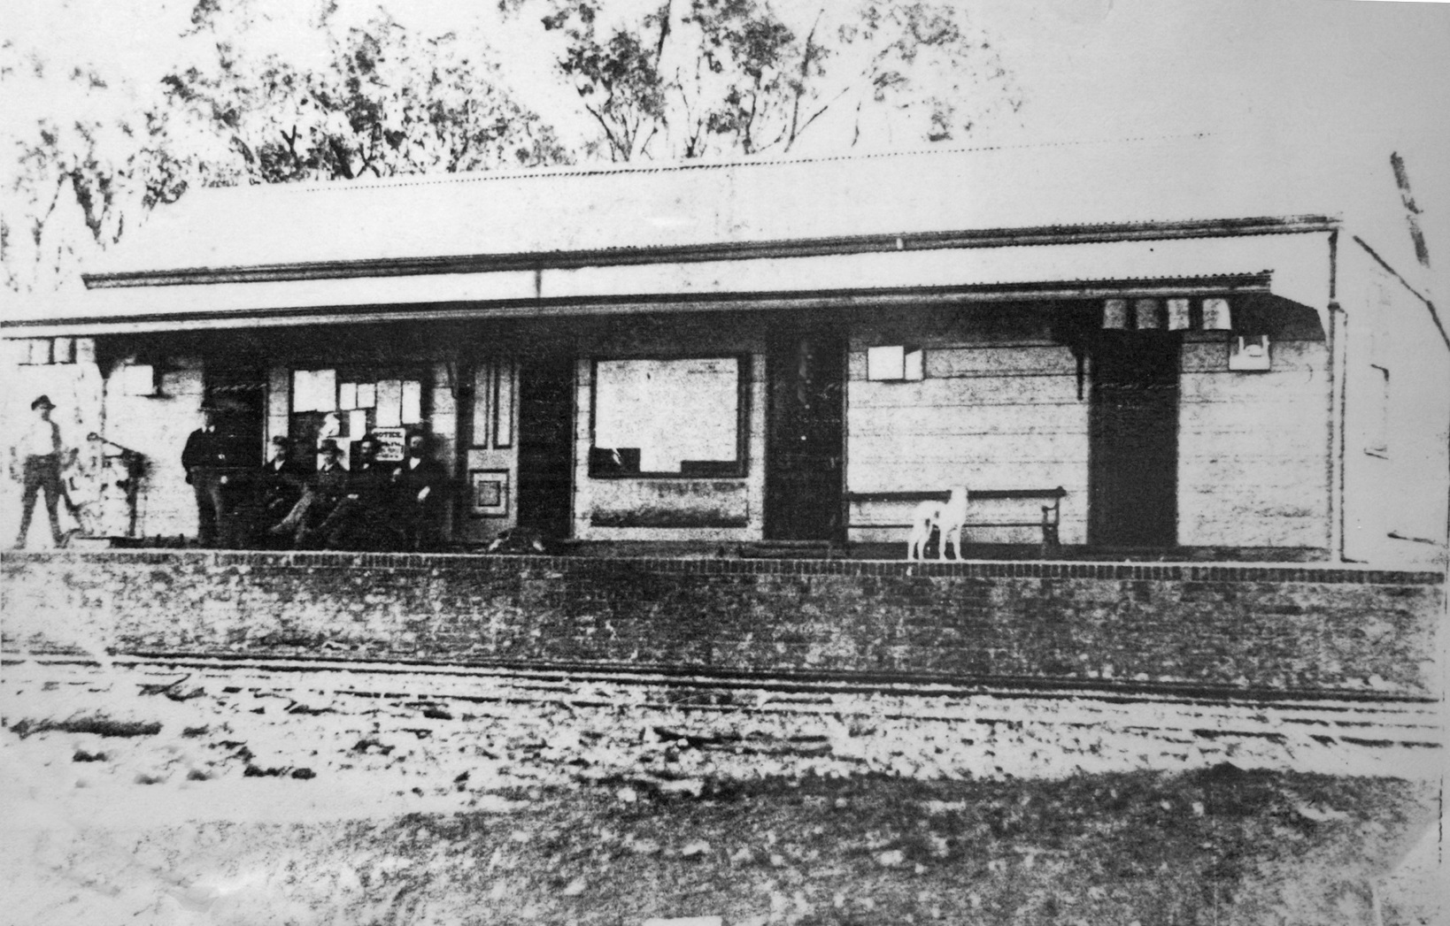
The first Glenbrook station- note the four canvas bags of drinking water hanging on the awning.
Photo about 1872

Slide 11
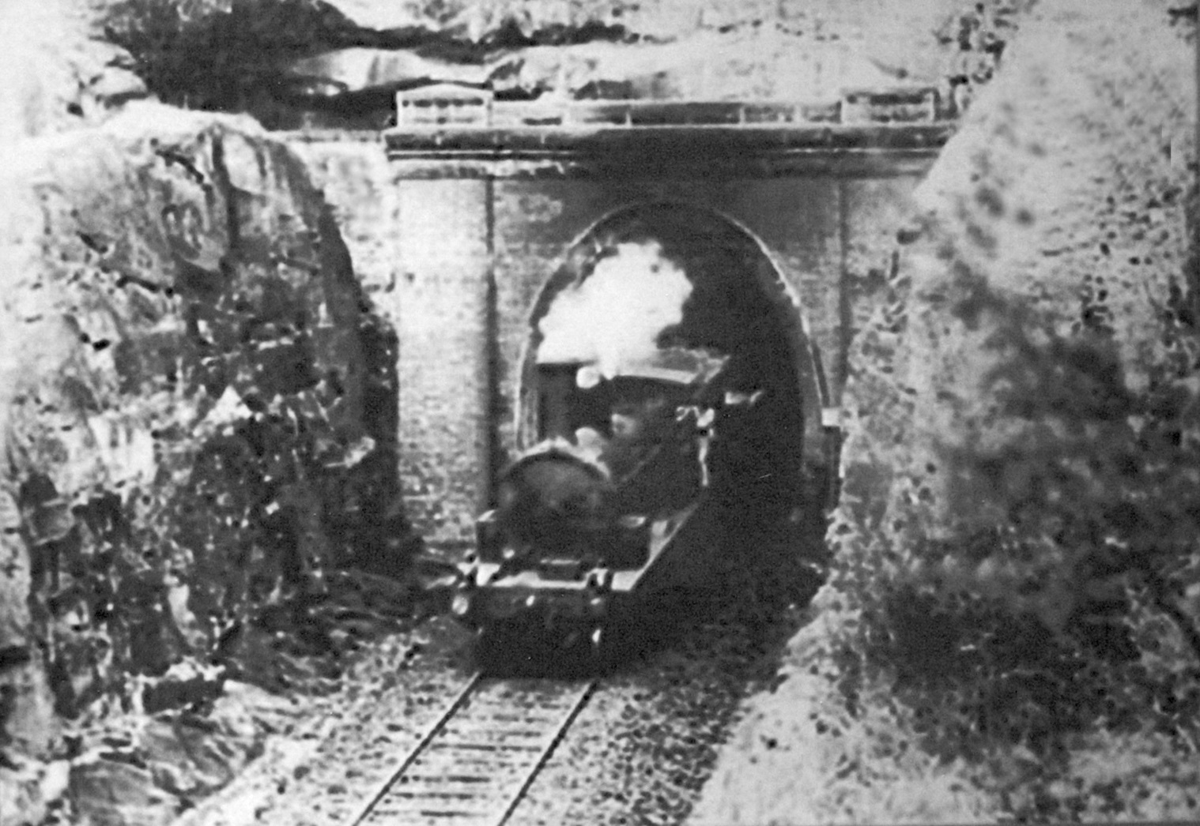
Sydney-bound train exiting east portal of Lapstone Tunnel.
Photo about 1912

Slide 12
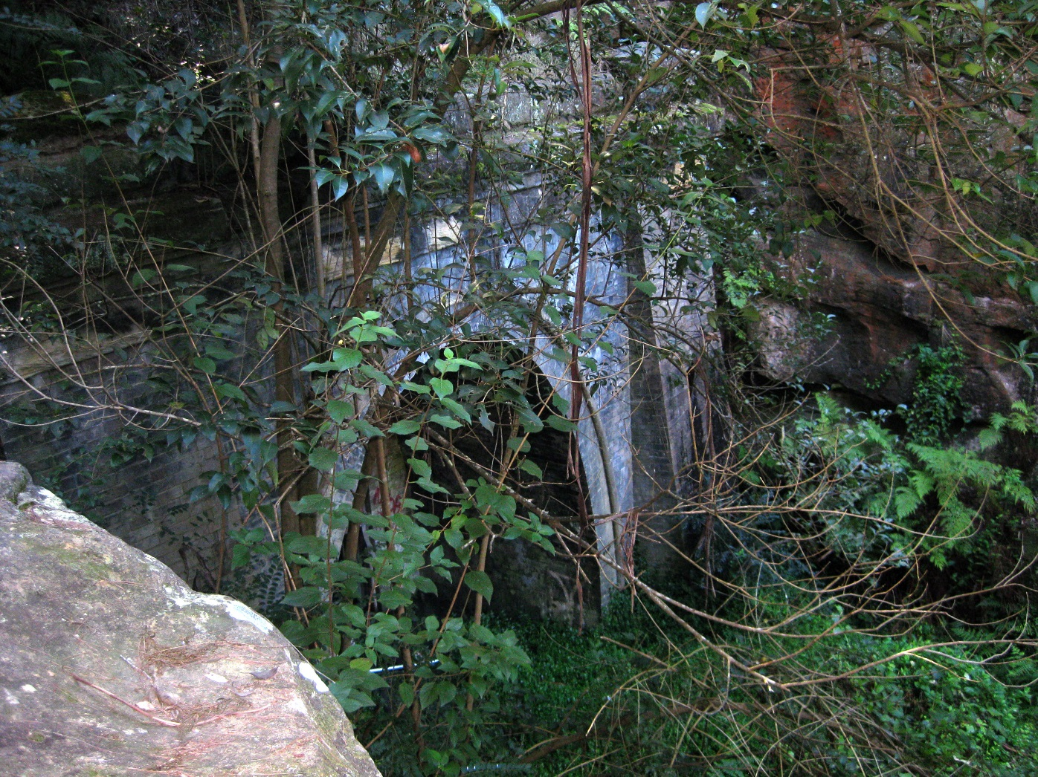
Lapstone Tunnel, east portal. Photo 2010

Slide 13
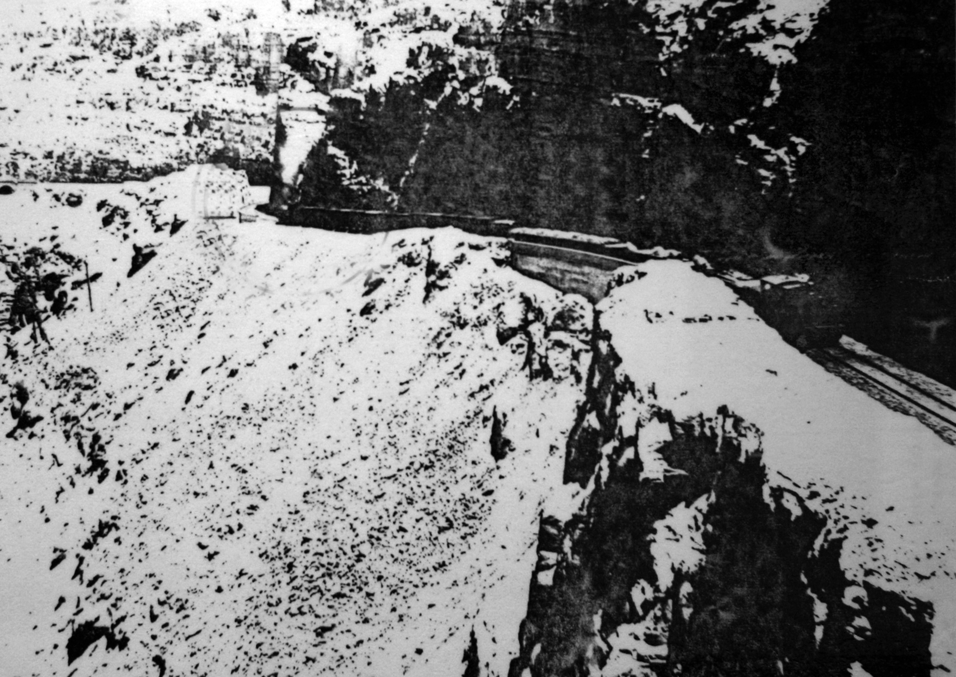

Slide 14
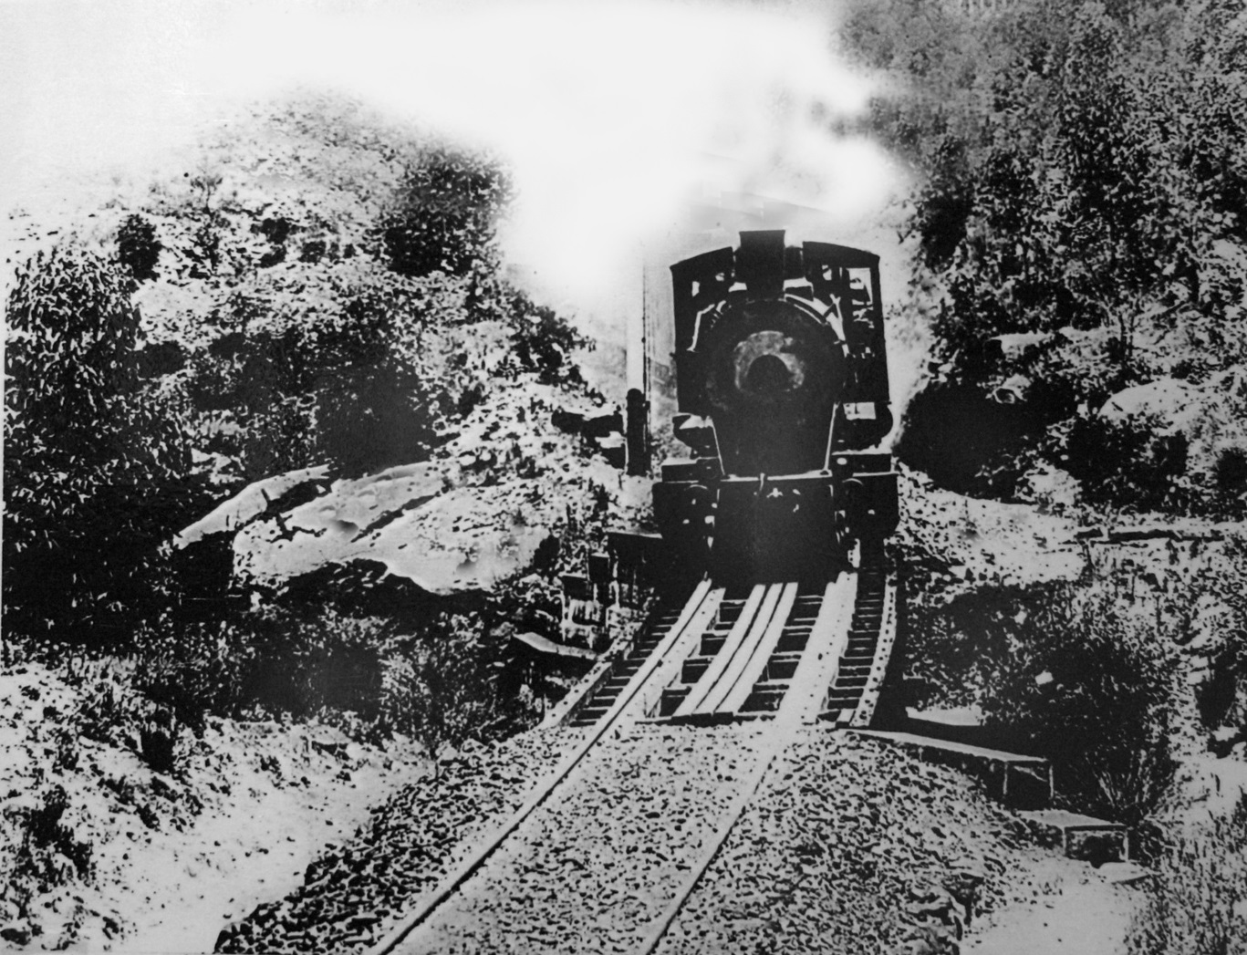
Sydney-bound train approaching west portal of Lapstone Tunnel. Photo about 1913

Slide 15
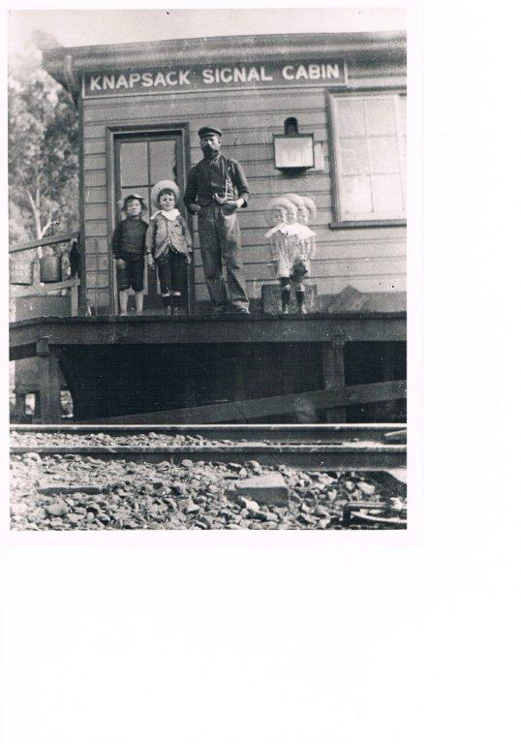

Slide 16
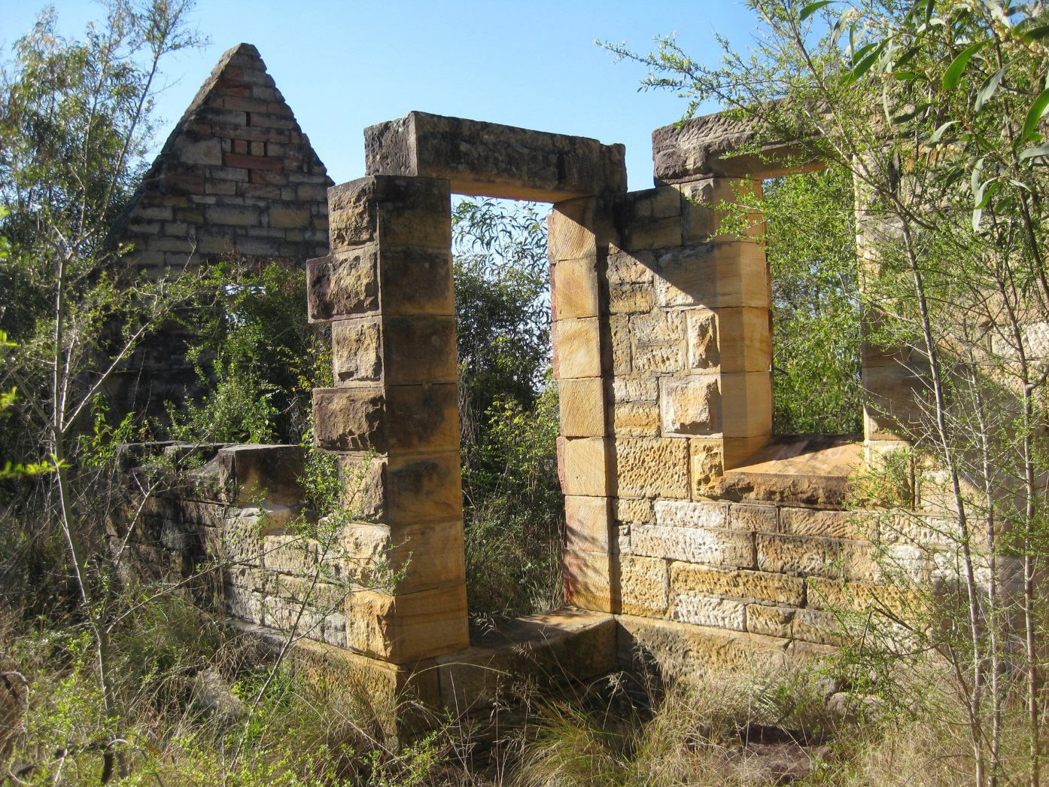
Gatekeepers Cottage ruin- destroyed in 1968 bushfires
The gatekeeper controlled the Western Road level crossing. Photo 2010

Slide 17
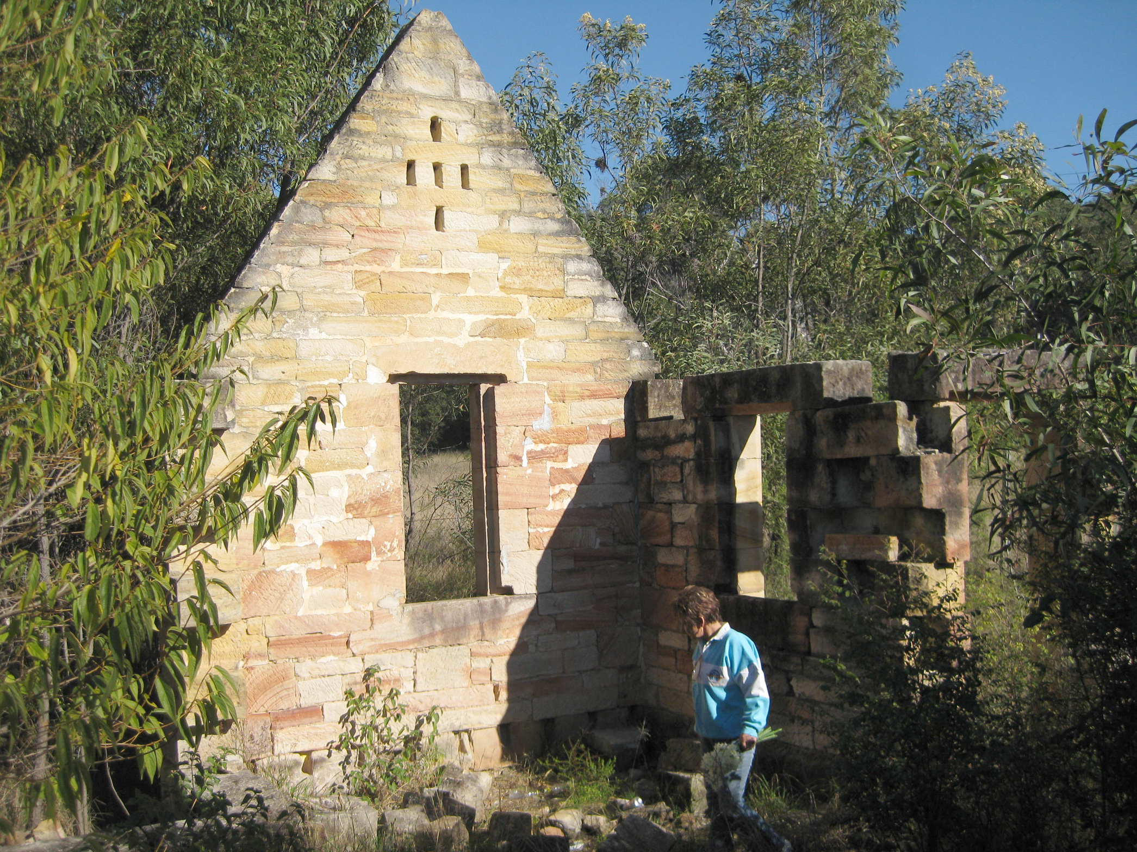

Slide 18
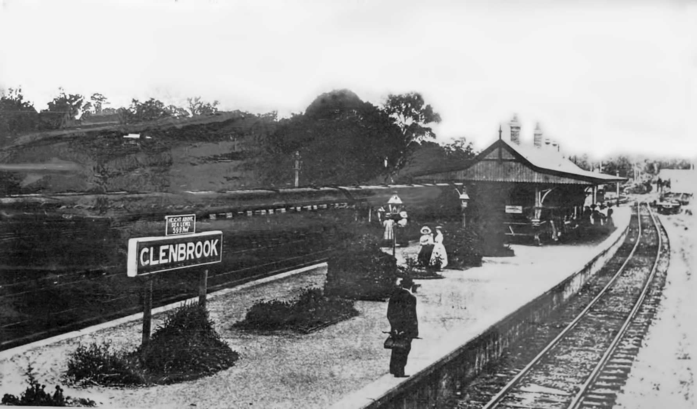
The second Glenbrook station – view looking east from pedestrian bridge.
Photo after 1890 and before 1913

Slide 19
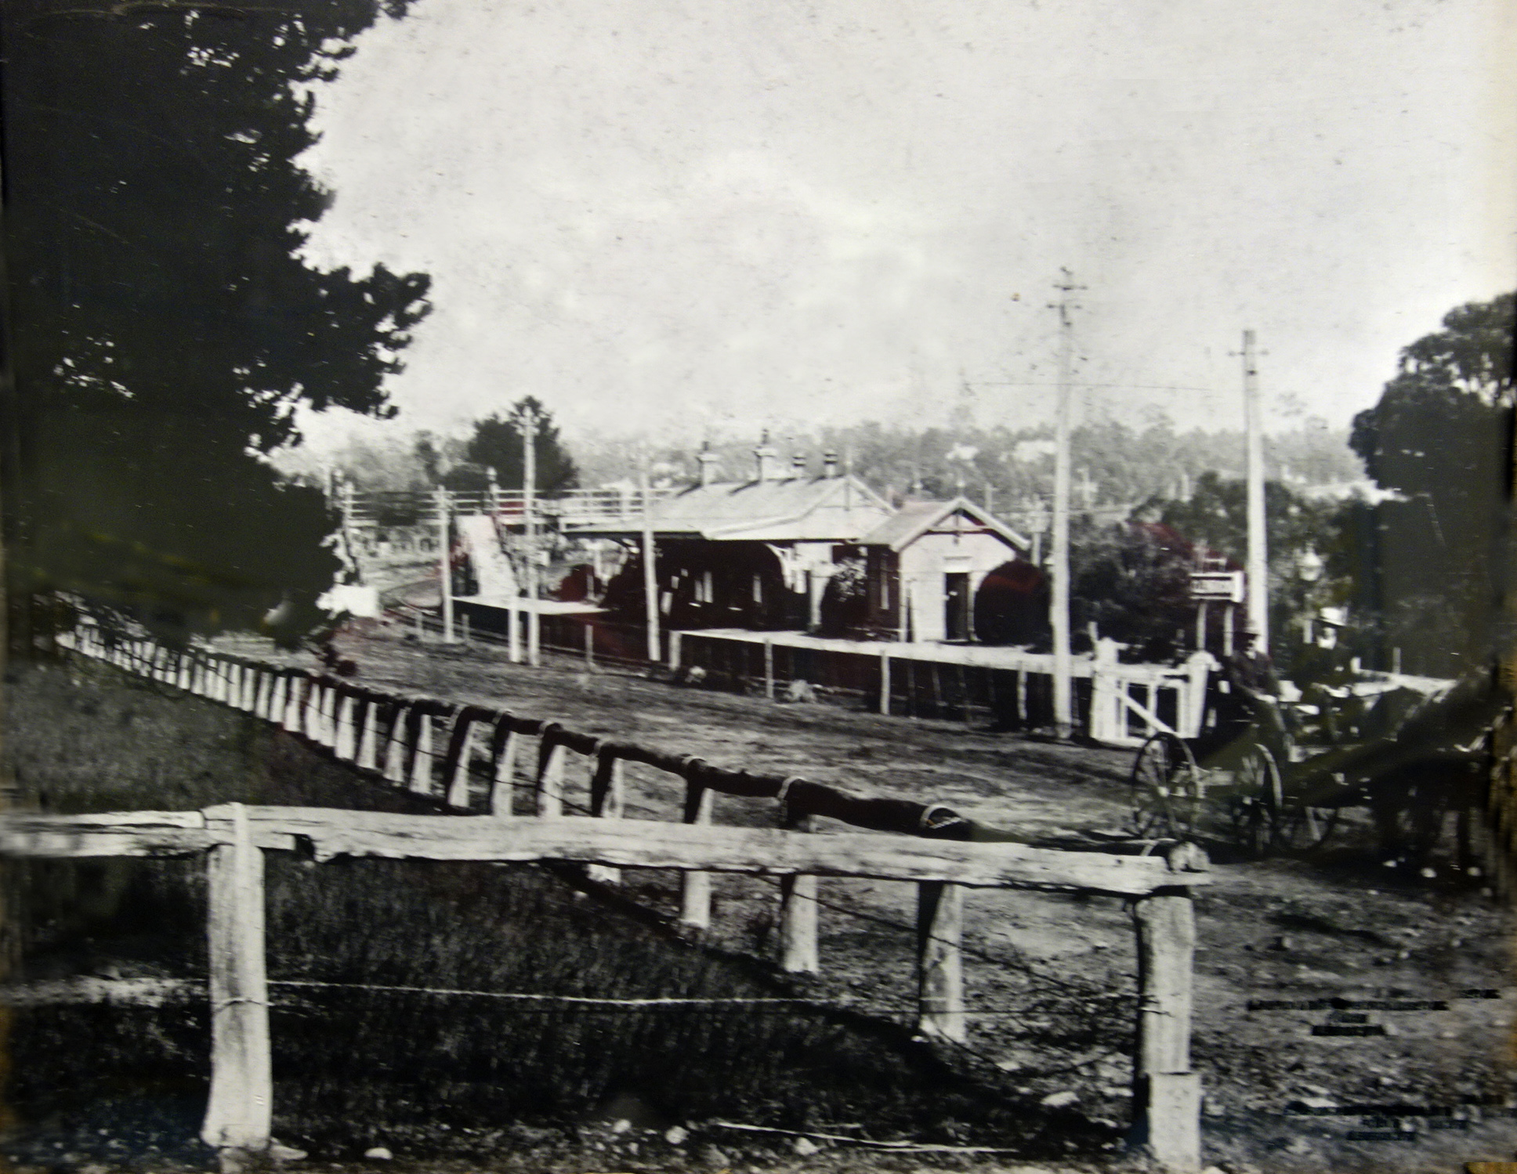

Slide 20
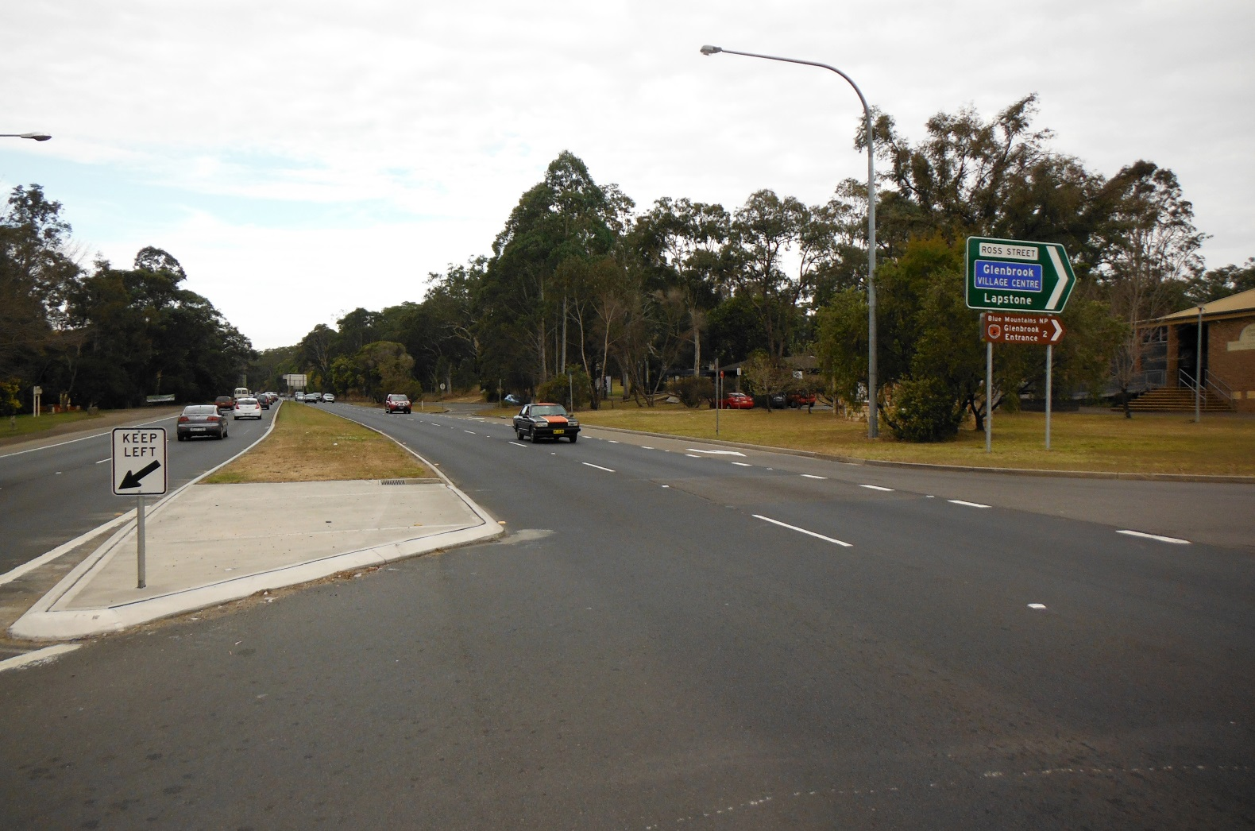

The same location now! Photo September 2013

Slide 21
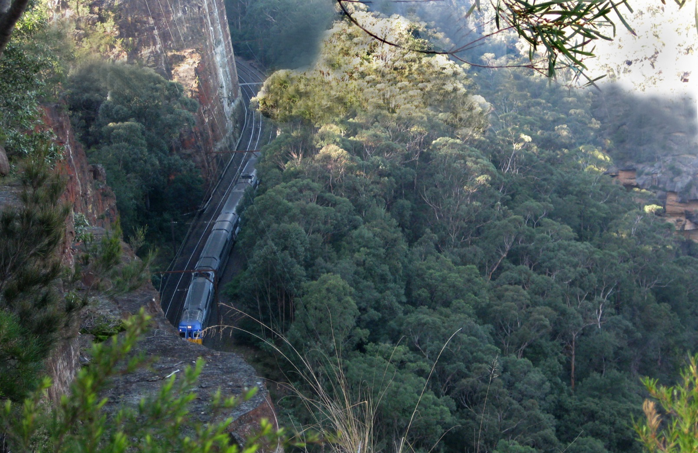
Glenbrook Gorge
This is the present route of the 1910-1913 double track railway with its spectacular deep cuttings. Photo 2010

Slide 22
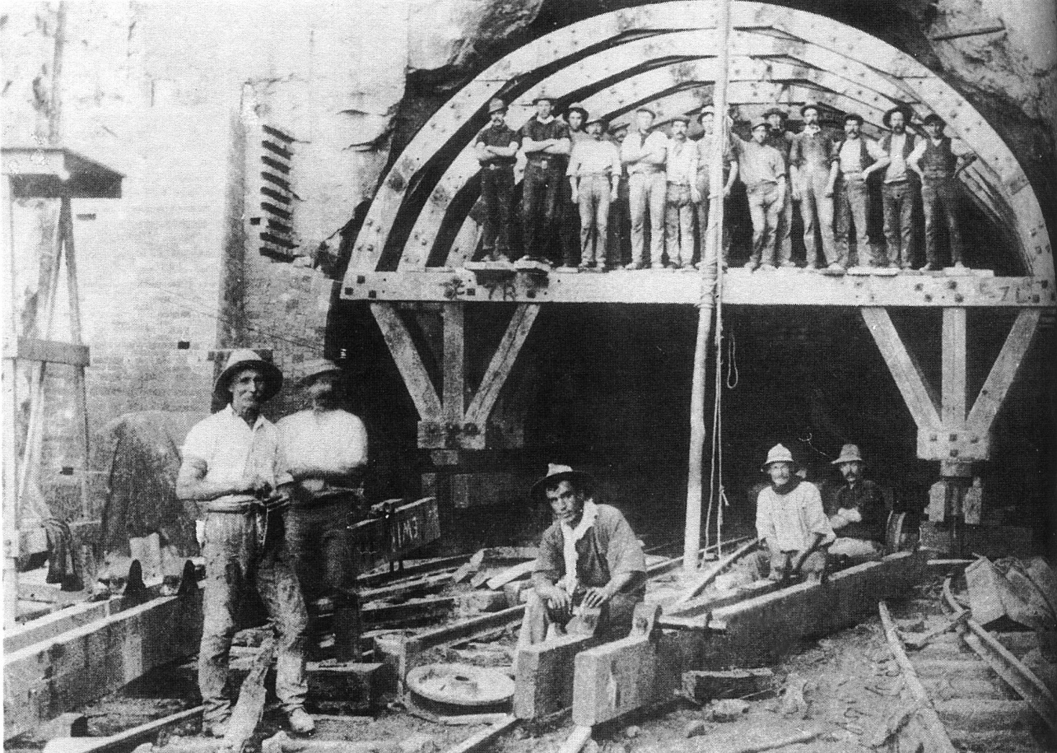
Glenbrook Tunnel- the Gorge route also needed a short double track tunnel.
Photo 1911

Slide 23
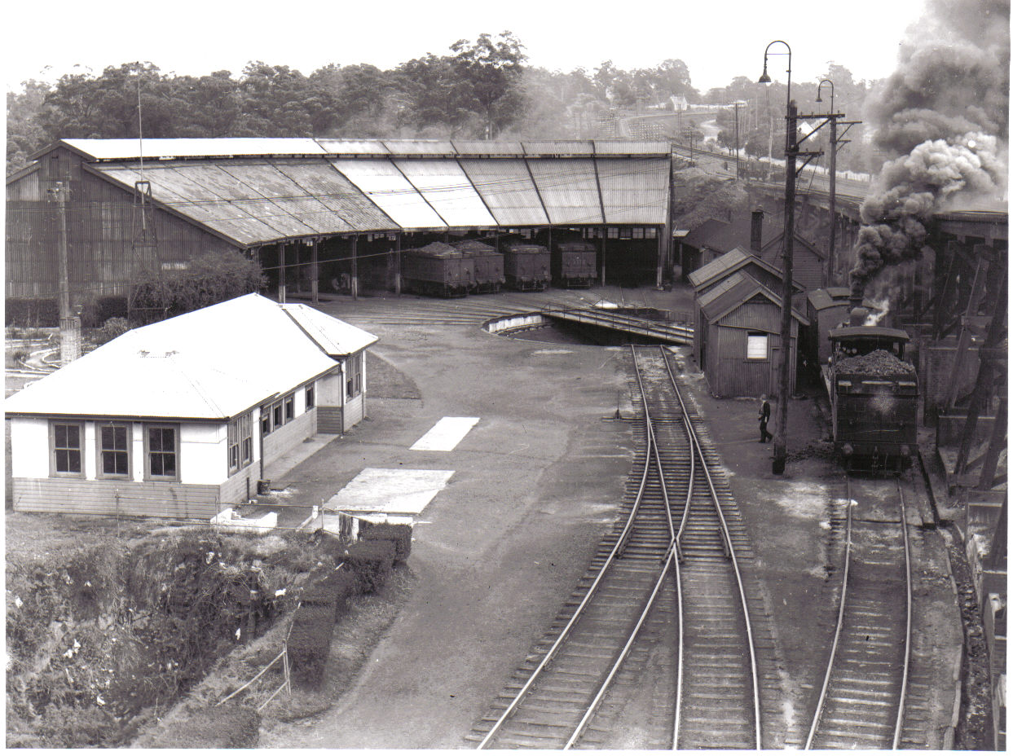
Valley Heights Locomotive Depot - Courtesy VHLDHM Collection Photo about 1950

Slide 24
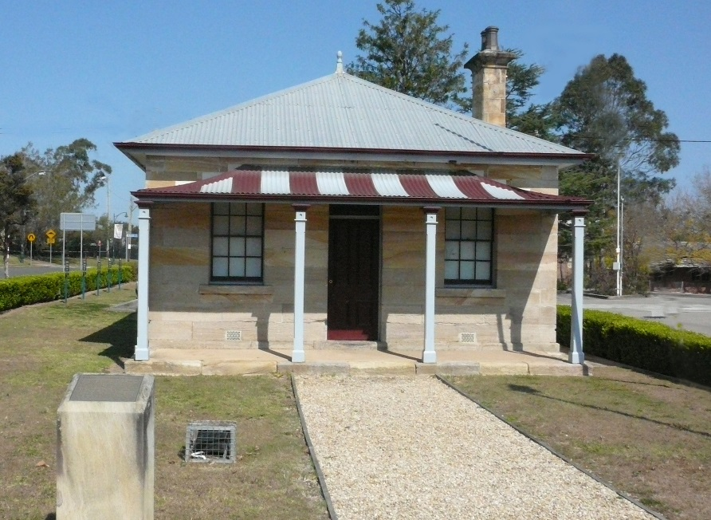
Pointsman’s Cottage

Slide 25
Acknowledgements and Credits
Prepared by the Glenbrook & District Historical Society for the Valley Heights Locomotive Depot Heritage Museum on the occasion of the depot centenary 2014.
Photos: Glenbrook & District Historical Society (except where otherwise indicated)
Captions: Doug Knowles
Motivation: Sue Fulton
Collation: Dick Morony
Technical: Ted Dickson
Photo of round house courtesy of Valley Heights Locomotive Heritage Museum
Other images used in this presentation have been previously reproduced in many publications and the original ownership is unclear.

